Slide 1
Justice & Evangelism

Slide 2
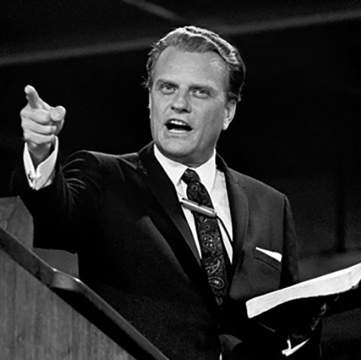
Why are we talking about Justice and Evangelism?
What is the first thing that comes to mind when you see this image?

Slide 3
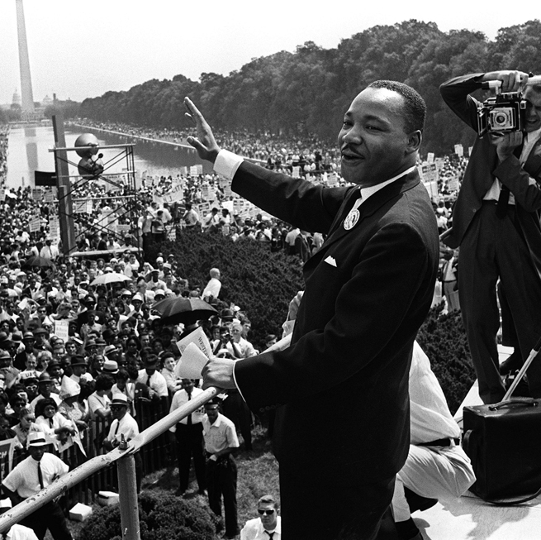
Why are we talking about Justice and Evangelism?
What is the first thing that comes to mind when you see this image?

Slide 4
Why are we talking about Justice and Evangelism?

Slide 5
Why are we talking about Justice and Evangelism?
GREAT COMMISSION
– GREAT COMMANDMENT
= INCOMPLETE LIFE
GREAT COMMANDMENT
– GREAT COMMISSION
= INCOMPLETE WITNESS

Slide 6
The Great Separation
Social Gospel and the Great Commandment (1870-1920)
The Great Reversal
(1920’s)

Slide 7
The Great Reversal
EVANGELISM
Gospel Proclamation
Great Commission
Individuals
Revivals
Church
JUSTICE
Gospel Implications
Great Commandment
Systems
Settlement Houses
Para-Church

Slide 8
Reconciliation
Lausanne I (1974)
Billy Graham and John Stott
The Lausanne Covenant
“I trust we can state…the relationships between evangelism and social responsibility…which disturbs many believers. Perhaps Lausanne can help clarify that.” – Billy Graham

Slide 9
Reconciliation
“Here…we express penitence both for our neglect and for having sometimes regarded evangelism and social concern as mutually exclusive. Although reconciliation with other people is not reconciliation with God, nor is social action evangelism, nor is political liberation salvation, nevertheless we affirm that evangelism and socio-political involvement are both part of our Christian duty.”
– Lausanne Covenant, Clause 5

Slide 10
Irreconcilable Differences
Challenging the Lausanne Covenant
Same House, Different Rooms

Slide 11
What Scripture Says
Genesis 1:27
Isaiah 1:17; Micah 6:8
Isaiah 58:12
Romans 9:1-5, 10:1
What do these passages of Scripture say about evangelism and/or justice?

Slide 12
What Scripture Says
“Now in these days when the disciples were increasing in number, a complaint by the Hellenists[a] arose against the Hebrews because their widows were being neglected in the daily distribution. And the twelve summoned the full number of the disciples and said, “It is not right that we should give up preaching the word of God to serve tables. Therefore, brothers, pick out from among you seven men of good repute, full of the Spirit and of wisdom, whom we will appoint to this duty. But we will devote ourselves to prayer and to the ministry of the word.” And what they said pleased the whole gathering, and they chose Stephen, a man full of faith and of the Holy Spirit, and Philip, and Prochorus, and Nicanor, and Timon, and Parmenas, and Nicolaus, a proselyte of Antioch. These they set before the apostles, and they prayed and laid their hands on them. And the word of God continued to increase, and the number of the disciples multiplied greatly in Jerusalem, and a great many of the priests became obedient to the faith.”
Acts 6:1-7

Slide 13
A Biblical Framework for Justice Based on Acts 6:1-7
Acknowledge
Address
Appoint

Slide 14
How to Share the Gospel
3 Circles: Life Conversation Guide
YouTube Video - How To Share My Faith: The 3 Circles from Covered Bridge Church
Life on Mission app from the North American Mission Board – on iPhone or Android

Slide 15
Evaluation
Which describes your Ministry: justice vs. evangelism or justice and evangelism ? How can you tell?
Do you separate justice and evangelism within your Ministry?
What Kingdom fruit do you have as evidence of a healthy balance between the two?
If you don’t have a healthy balance, what can you do differently? What action steps can you take to build the Words of the Gospel into your ministry? (Word Strategy on next slide)

Slide 16
Evaluation (cont.)
Word Strategy defined – For every justice or mercy ministry, a church affixes a means by which the recipients of ministry will be exposed to the gospel
Brainstorm some Word Strategies for your ministry context.
Visitation
Evangelistic literature
Evangelistic public speaking at a venue
Evangelistic meals where testimony is shared
Bible studies / small groups
Examples:

Slide 17
Evaluation (cont.)
A couple of Cautions
Use sensitivity – the recipients of aid should not feel that they must endure some “sales pitch” to get help. But, on the other hand, it is not right (in the name of sensitivity) to make no conscious, structured effort to share the gospel with those who receive aid.
Contextualize – it is not enough to attach a gospel presentation to a ministry of mercy. On the basis of your understanding of a person’s hopes, values, worldview and lifestyle, the gospel message must be contextualized, adapted to the language and capacities of the man, woman, or child you are aiding.

